Slide 1
Introducing Visual Studio Code
(for Windows, Linux, Mac and others)
Eric Flamm, Flamm Consulting
eric@flammconsulting.com
@eflamm
@AtlCodeCamp
http://AtlantaCodeCamp.com

Slide 2

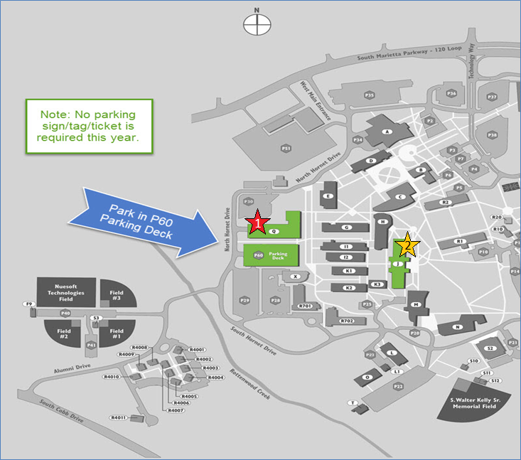

Slide 3



Platinum Sponsors

Slide 4
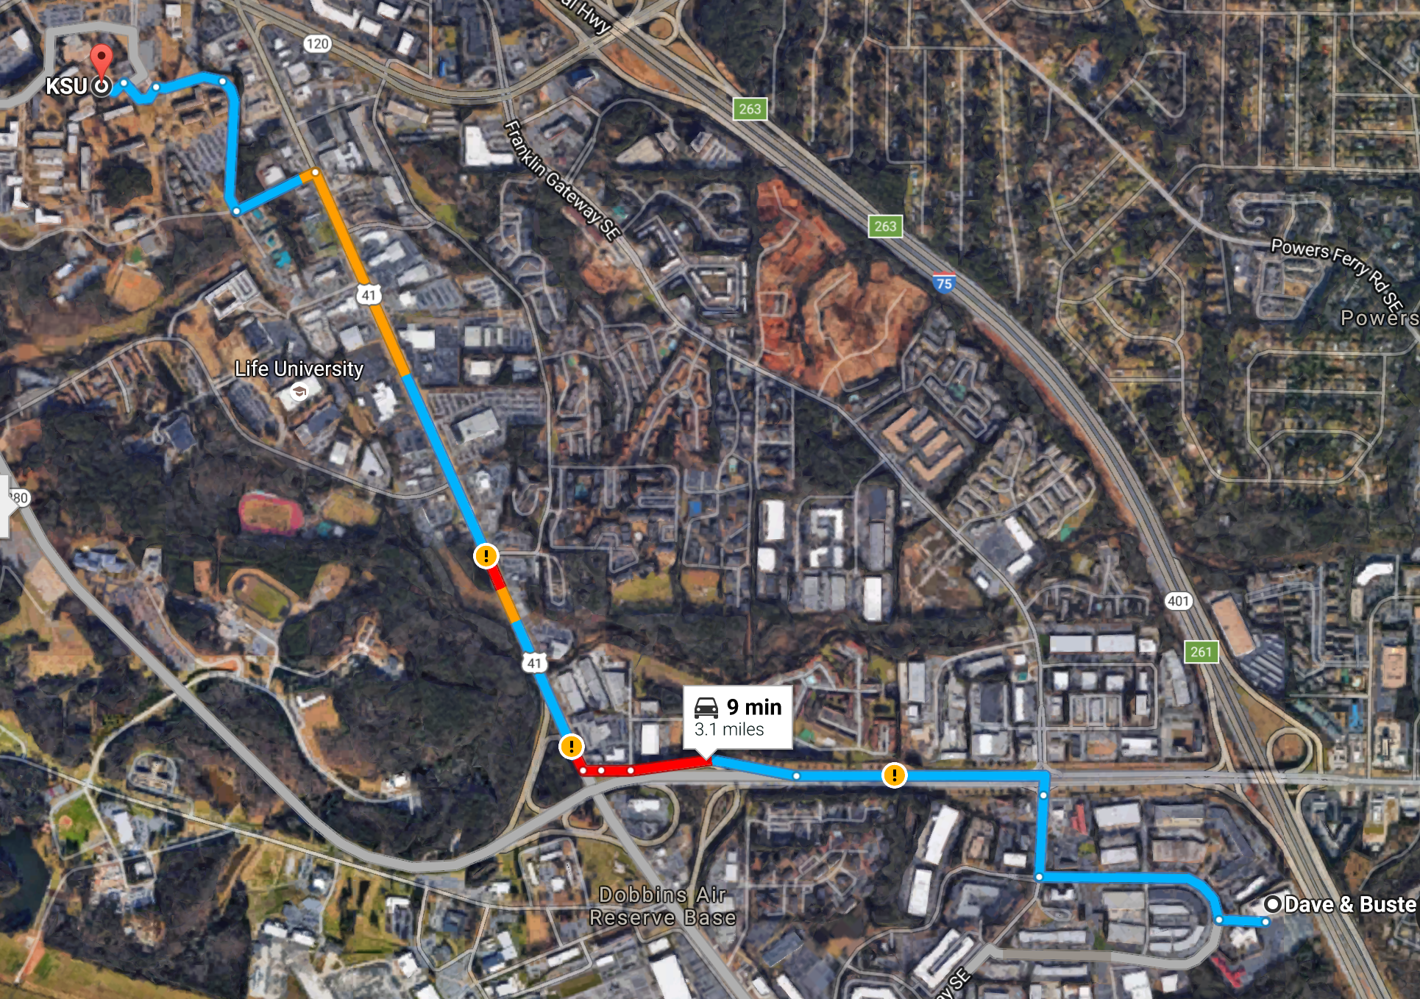

After Party – Dave & Busters
2215 D&B Drive Southeast Marietta, GA
Sponsored By:

Slide 5



Gold Sponsors

Slide 6
Silver Sponsors

Slide 7
Agenda
Intro
About VS Code
How to get VS Code
Demo – code.visualstudio.com
Use Case Demos
PowerShell
MS SQL
Angular
Resources
Q & A

Slide 8
About Me
Independent Business Intelligence/Analytics Consultant
MCP: Querying Microsoft SQL Server 2012
Member of TAG Data Science and Analytics Society Board
Active Volunteer with Atlanta Microsoft Database Forum (local PASS Chapter)
Organizing Committee for Atlanta SQL Saturday since 2010
Contact Info:
E-mail: eric@flammconsulting.com
Mobile: (678) 524-4256
Twitter: @eflamm
Web: www.flammconsulting.com

Slide 9
Poll
Heard of VS Code
Used VS Code
Can’t live without it – just came to heckle!

Slide 10
About VS Code
Home Page: code.visualstudio.com/
Built on Electron Shell using Python on Node.js
Built to support Javascript/TypeScript development
1000’s of extensions provide support for multiple languages/development environments
GitHub Repo: https://github.com/Microsoft/vscode

Slide 11
How to Get VS Code
Windows – Download and run the installer from the VS Code Getting Started page
Linux – Depends on the distro – download the appropriate package, update the package store, and install with yum or apt‐get
Mac – download the VS Code archive from https://code.visualstudio.com/docs/setup/mac and expand it to retrieve the app launcher

Slide 12

Demo – code.visualstudio.com

Slide 13
Use Case Demos
PowerShell (Windows)
MS SQL – Linux Desktop
Angular – Mac Desktop

Slide 14
Resources
Keyboard Shortcuts – use Help->Keyboard Shortcuts Reference to print 1-page PDF
Welcome Screen (Help->Welcome)
Set of 8 Intro Videos available from Welcome Screen
Interactive Playground
Links to recent files and folders

Slide 15
Q & A

Slide 16
Reminders
Fill out SESSION EVALs – FEEDBACK is a GIFT!
Fill out EVENT EVAL – see above!
Sponsor Booth Game – Special Swag drawing
Closing in Building Q Auditorium – Giveaways
After Party at Dave & Buster’s

